Slide 1
NEXUS-PRIME
Adaptive AI Integration Platform • Presentation MVP
Founder: Michael Sanders • Spec v1.0 • Feb 10, 2026

Slide 2
The Problem
Teams lose time integrating analytics, support, and monitoring across many SaaS apps.
Insights are fragmented: metrics dashboards don’t explain root cause or recommend fixes.
Building connectors + copilots is expensive; every app has a different schema and API surface.
NEXUS-PRIME • Feb 2026

Slide 3
NEXUS-PRIME: What it does
Connects to a target application (REST APIs / DBs).
Runs automated discovery to map endpoints + data tables.
Provides natural-language commands: ask questions, generate reports, export data.
Generates predictive insights (performance, churn, feature usage) with confidence + impact.
Embedded support QA that answers end-user questions in-context.
NEXUS-PRIME • Feb 2026

Slide 4
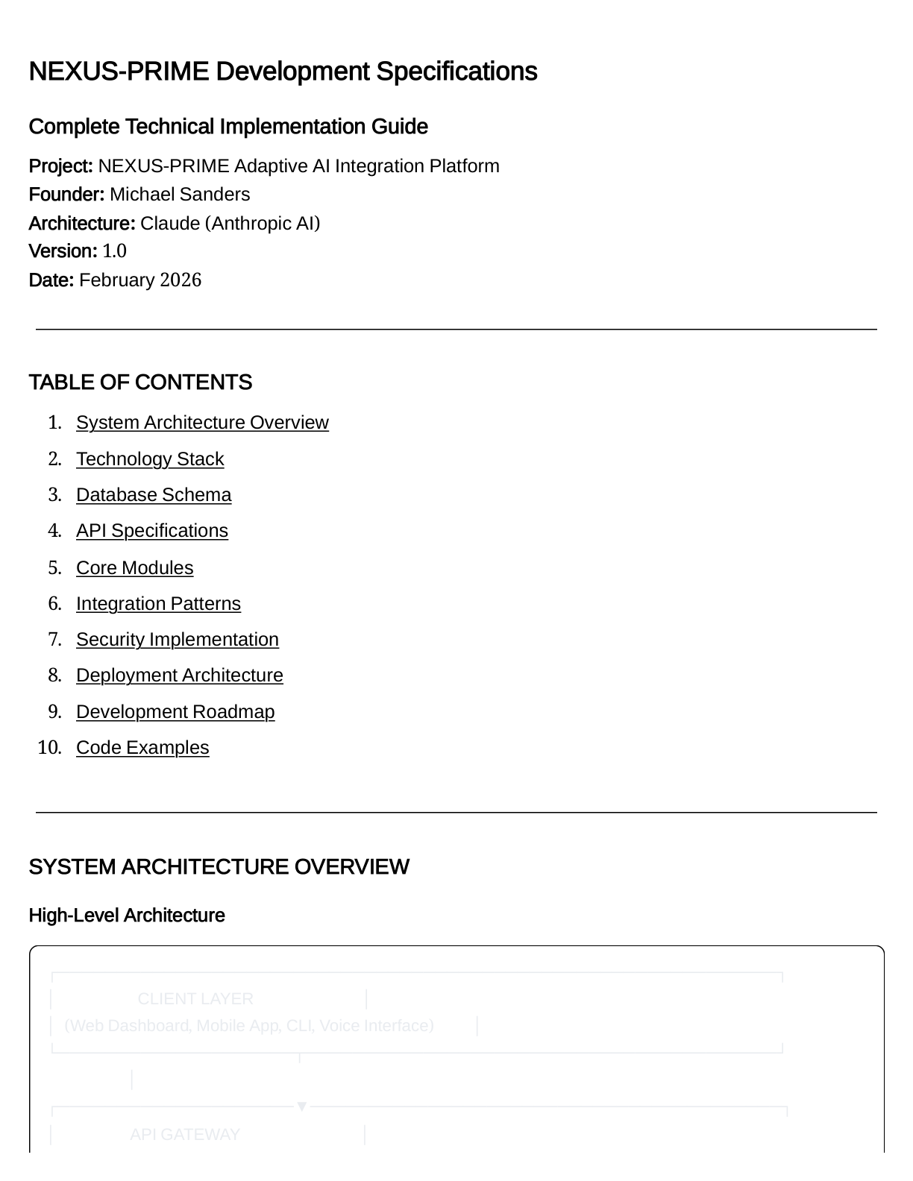
High-Level Architecture
NEXUS-PRIME • Feb 2026

Slide 5
Core Modules in this MVP
1) Application Discovery
Scans OpenAPI/Swagger (or probes) to build an endpoint map.
2) NL Command Processor
Extracts intent + parameters and routes to services.
3) Predictive Insights
Heuristics aligned with the spec examples (latency, errors, conversion).
4) Codegen (Phase 2)
MVP returns a structured implementation plan (no source mutation).
NEXUS-PRIME • Feb 2026

Slide 6
API Surface (Spec-aligned)
POST /v1/applications • GET /v1/applications/{id}
POST /v1/applications/{id}/connections • POST /v1/connections/{id}/scan
POST /v1/commands • GET /v1/commands/{id}
GET /v1/applications/{id}/metrics • POST /v1/applications/{id}/analytics/query
GET /v1/applications/{id}/insights • PUT /v1/insights/{id}
POST /v1/applications/{id}/support/query • POST /v1/webhooks
NEXUS-PRIME • Feb 2026

Slide 7
Security (MVP)
JWT auth (register/login) + optional API key access.
Per-hour rate limiting (Redis-backed; in-memory fallback).
Connection credentials encrypted at rest (Fernet).
CORS configurable for the dashboard.
NEXUS-PRIME • Feb 2026

Slide 8
Deployment for Demo
docker compose up --build
Services: Postgres • Redis • FastAPI API • React dashboard
Swagger docs: http://localhost:8000/docs
Dashboard: http://localhost:5173
NEXUS-PRIME • Feb 2026

Slide 9
Live Demo (Suggested Flow)
1) Register in dashboard → token stored locally
2) Create Application → Add Connection → Scan (discovers endpoints)
3) View Metrics chart + generated Insights
4) Run NL Command: “Show me why conversions dropped yesterday”
5) Ask Support: “How do I export my data?”
NEXUS-PRIME • Feb 2026

Slide 10
Roadmap (From Spec)
Phase 1: Core platform (API gateway, discovery, command execution).
Phase 2: Advanced analytics + ML models (ClickHouse, vector DB, embeddings).
Phase 3: Code generation engine (safe diffs, PR creation, testing automation).
Phase 4: Scale + enterprise (Kubernetes, observability, SSO, RBAC).
NEXUS-PRIME • Feb 2026

Slide 11
Q&A
Questions?
NEXUS-PRIME • Feb 2026

